Slide 1
EE 4780
Image Segmentation

Slide 2
Image Segmentation
Group similar components (such as, pixels in an image, image frames in a video) to obtain a compact representation.
Applications: Finding tumors, veins, etc. in medical images, finding targets in satellite/aerial images, finding people in surveillance images, summarizing video, etc.
Methods: Thresholding, K-means clustering, etc.

Slide 3
Image Segmentation
Segmentation algorithms for monochrome images generally are based on one of two basic properties of gray-scale values:
  Discontinuity
    The approach is to partition an image based on abrupt changes in gray-scale levels.
    The principal areas of interest within this category are detection of isolated points, lines, and edges in an image.
  Similarity
    The principal approaches in this category are based on thresholding, region growing, and region splitting/merging.

Slide 4
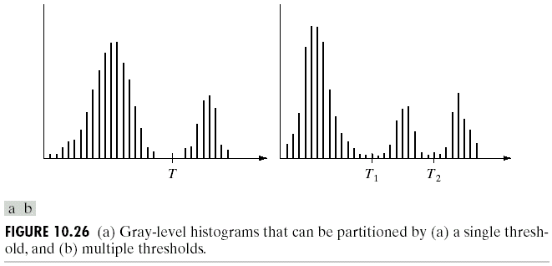
Thresholding
Suppose that an image, f(x,y), is composed of light objects on a dark backround, and the following figure is the histogram of the image.
Then, the objects can be extracted by comparing pixel values with a threshold T.

Slide 5
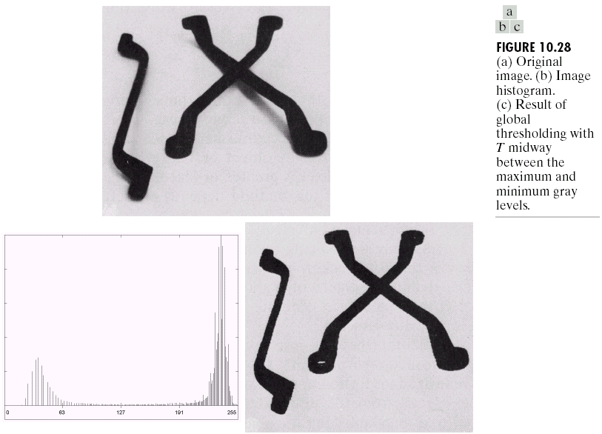
Thresholding

Slide 6
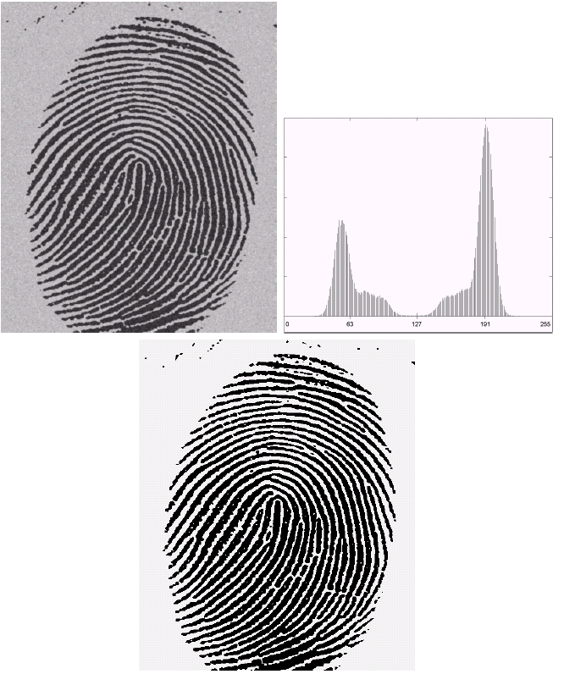
Thresholding

Slide 7
Thresholding
It is also possible to extract objects that have a specific intensity range using multiple thresholds.
Extension to color images is straightforward: There are three color channels, in each one specify the intensity range of the object… Even if objects are not separated in a single channel, they might be with all the channels… Application example: Detecting/Tracking faces based on skin color…

Slide 8
Thresholding
Exercise: Cost of classifying a background pixel as an object pixel is Cb.
Cost of classifying an object pixel as a background pixel is Co.
Find the threshold, T, that minimizes the total cost.
Background
h1
Object
h2
a
2a
T

Slide 9
Thresholding
Non-uniform illumination may change the histogram in a way that it becomes impossible to segment the image using a single global threshold.
Choosing local threshold values may help.

Slide 10
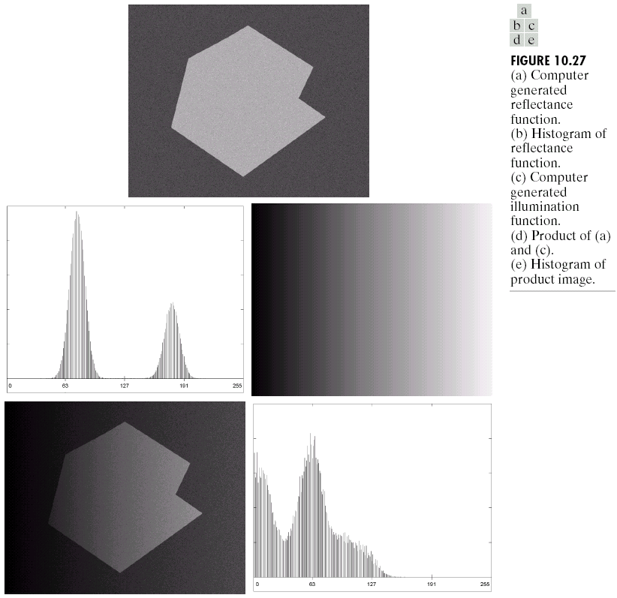
Thresholding

Slide 11
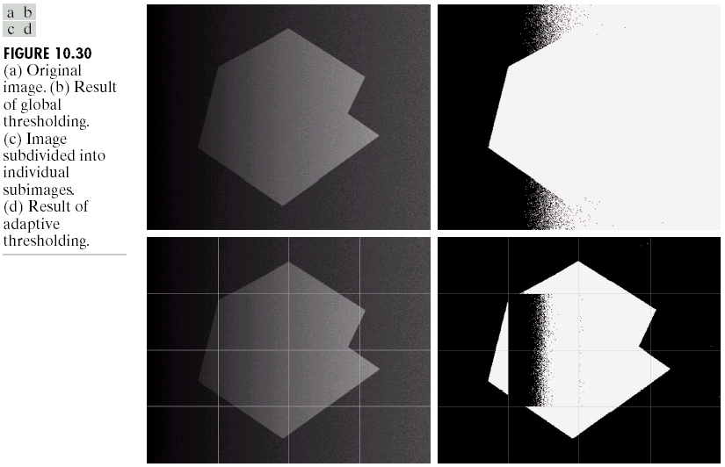
Thresholding
Adaptive thresholding

Slide 12
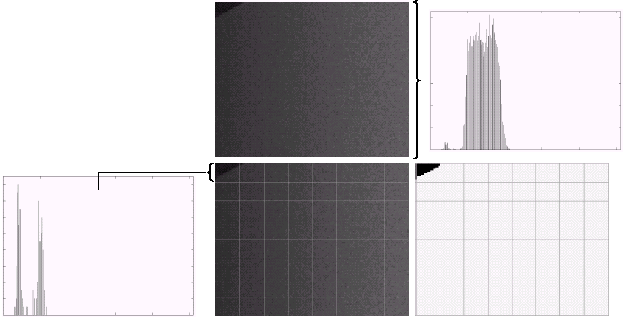
Thresholding
Almost constant illumination →Separation of objects…

Slide 13
Region-Oriented Segmentation
Region Growing
  Region growing is a procedure that groups pixels or subregions into larger regions.
  The simplest of these approaches is pixel aggregation, which starts with a set of “seed” points and from these grows regions by appending to each seed points those neighboring pixels that have similar properties (such as gray level, texture, color, shape).
  Region growing based techniques are better than the edge-based techniques in noisy images where edges are difficult to detect.

Slide 14
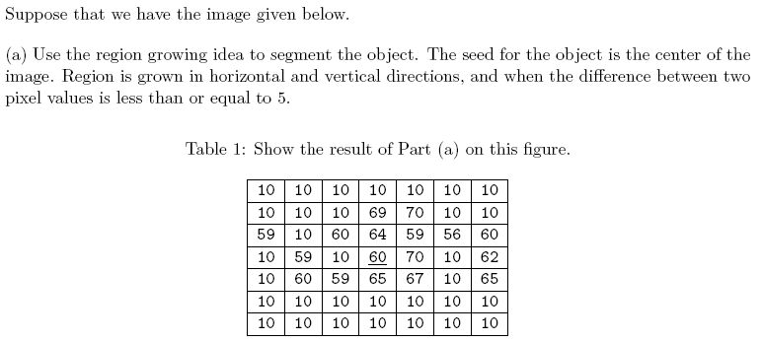
Region-Oriented Segmentation

Slide 15
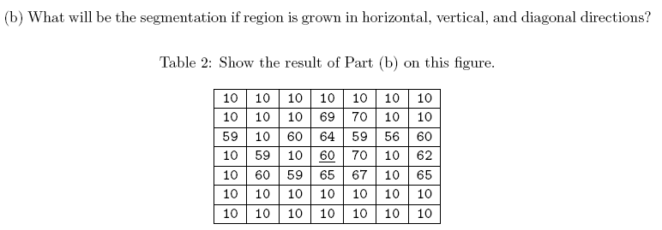
Region-Oriented Segmentation

Slide 16
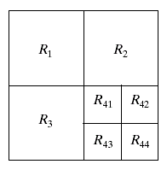
Region-Oriented Segmentation
Region Splitting
  Region growing starts from a set of seed points.
  An alternative is to start with the whole image as a single region and subdivide the regions that do not satisfy a condition of homogeneity.
Region Merging
  Region merging is the opposite of region splitting.
  Start with small regions (e.g. 2x2 or 4x4 regions) and merge the regions that have similar characteristics (such as gray level, variance).
  Typically, splitting and merging approaches are used iteratively.

Slide 17
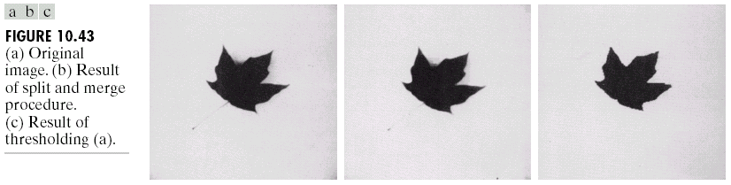
Region-Oriented Segmentation

Slide 18
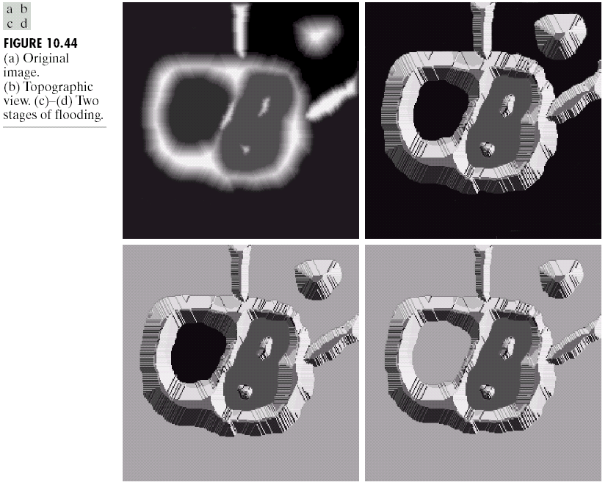
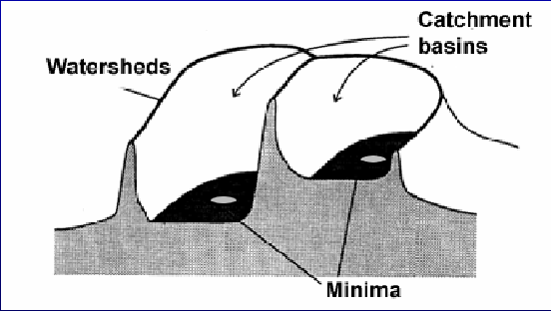
Watershed Segmentation Algorithm
Visualize an image in 3D: spatial coordinates and gray levels.
In such a topographic interpretation, there are 3 types of points:
  Points belonging to a regional minimum
  Points at which a drop of water would fall to a single minimum. (→The catchment basin or watershed of that minimum.)
  Points at which a drop of water would be equally likely to fall to more than one minimum. (→The divide lines or watershed lines.)
Watershed lines

Slide 19
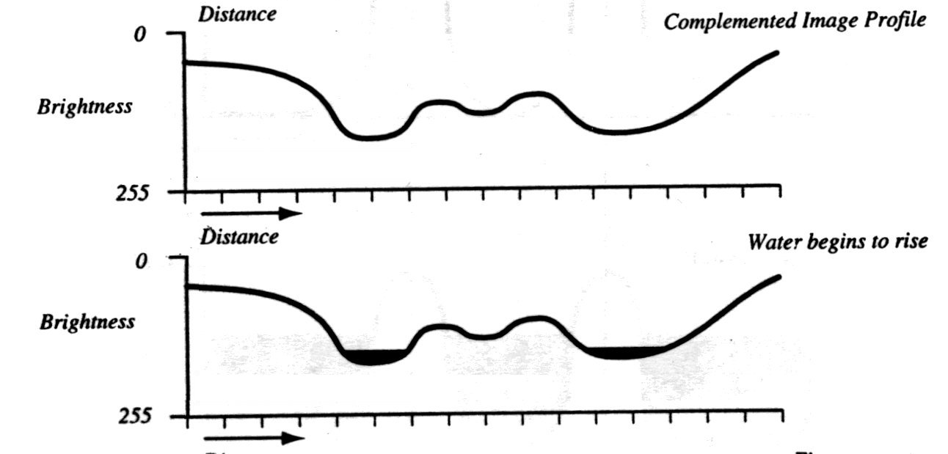
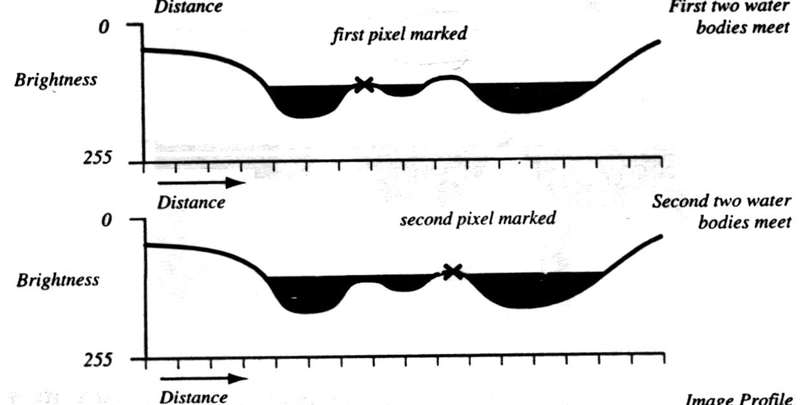
Watershed Segmentation Algorithm
The objective is to find watershed lines.
The idea is simple:
  Suppose that a hole is punched in each regional minimum and that the entire topography is flooded from below by letting water rise through the holes at a uniform rate.
  When rising water in distinct catchment basins is about the merge, a dam is built to prevent merging. These dam boundaries correspond to the watershed lines.

Slide 20
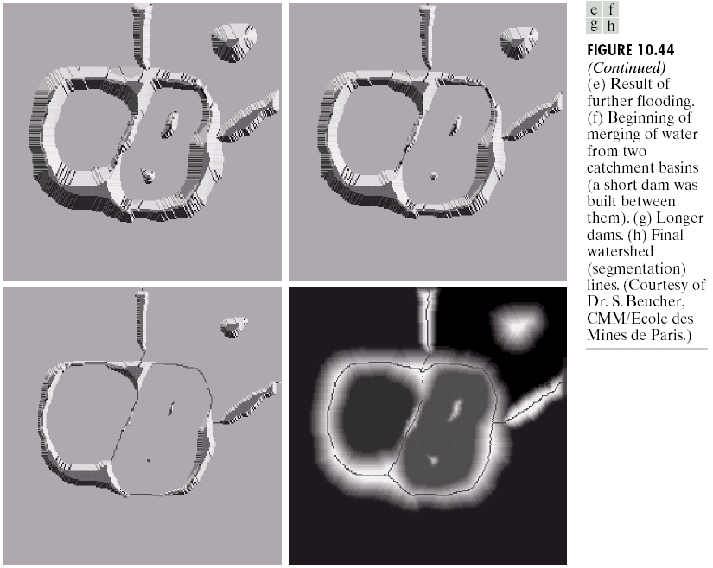
Watershed Segmentation Algorithm

Slide 21
Watershed Segmentation Algorithm
Start with all pixels with the lowest possible value.
  These form the basis for initial watersheds
For each intensity level k:
  For each group of pixels of intensity k
    If adjacent to exactly one existing region, add these pixels to that region
    Else if adjacent to more than one existing regions, mark as boundary
    Else start a new region

Slide 22
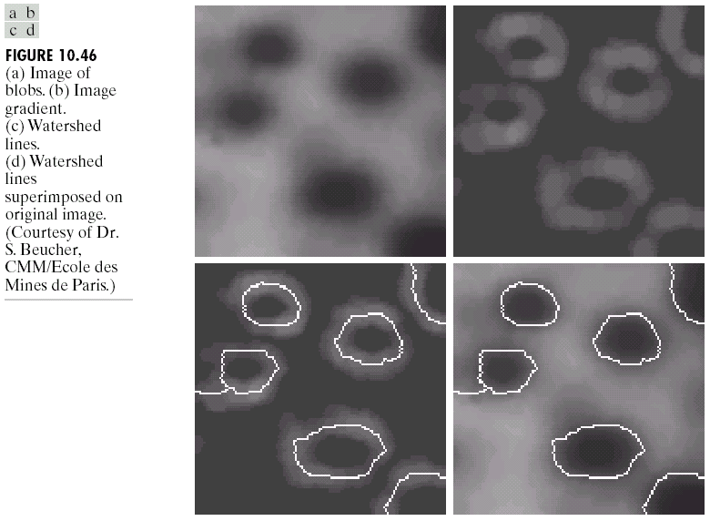
Watershed Segmentation Algorithm
Watershed algorithm might be used on the gradient image instead of the original image.

Slide 23
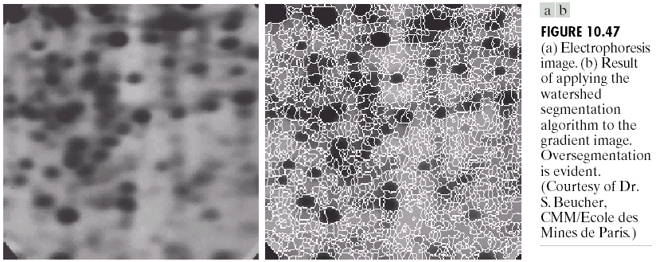
Watershed Segmentation Algorithm
Due to noise and other local irregularities of the gradient, oversegmentation might occur.

Slide 24
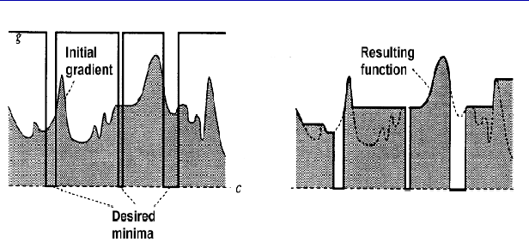
Watershed Segmentation Algorithm
A solution is to limit the number of regional minima. Use markers to specify the only allowed regional minima.

Slide 25
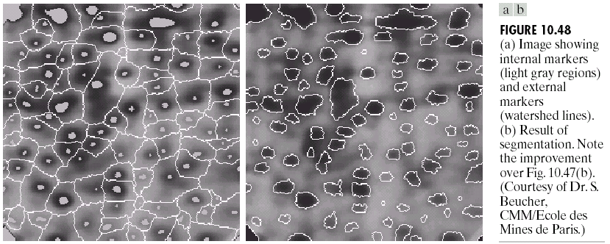
Watershed Segmentation Algorithm
A solution is to limit the number of regional minima. Use markers to specify the only allowed regional minima. (For example, gray-level values might be used as a marker.)

Slide 26
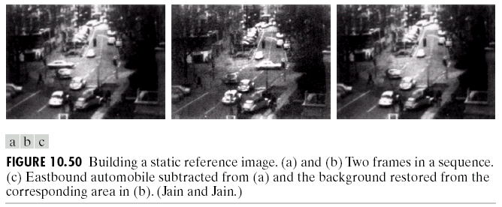
Use of Motion In Segmentation
Take the difference between a reference image and a subsequent image to determine the stationary elements and nonstationary image components.

Slide 27
K-Means Clustering
Partition the data points into K clusters randomly. Find the centroids of each cluster.
For each data point:
  Calculate the distance from the data point to each cluster.
  Assign the data point to the closest cluster.
Recompute the centroid of each cluster.
Repeat steps 2 and 3 until there is no further change in the assignment of data points (or in the centroids).

Slide 28
K-Means Clustering

Slide 29
K-Means Clustering

Slide 30
K-Means Clustering

Slide 31
K-Means Clustering

Slide 32
K-Means Clustering

Slide 33
K-Means Clustering

Slide 34
K-Means Clustering

Slide 35
K-Means Clustering

Slide 36
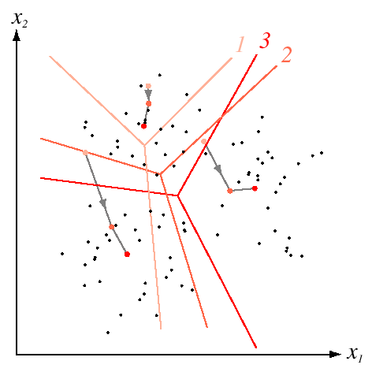
K-Means Clustering
Example
Duda et al.

Slide 37
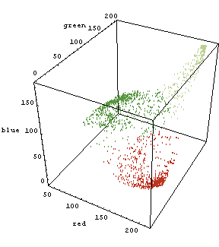
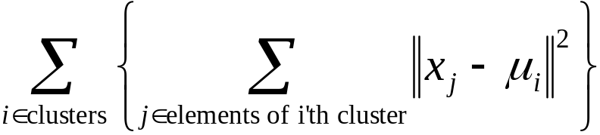
K-Means Clustering
RGB vector
K-means clustering minimizes

Slide 38
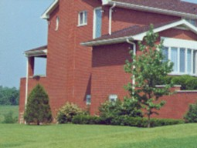
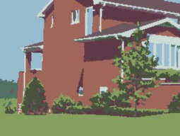
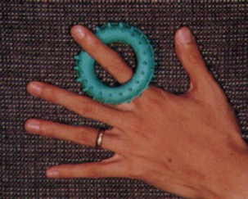

Clustering
Example
D. Comaniciu and P. Meer, Robust Analysis of Feature Spaces:
Color Image Segmentation, 1997.

Slide 39
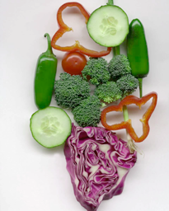
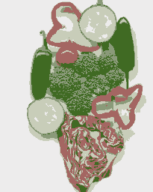
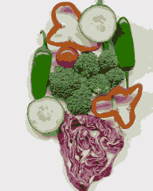
K-Means Clustering
Example
Original
K=5
K=11

Slide 40




K-means, only color is used in segmentation, four clusters (out of 20) are shown here.

Slide 41




K-means, color and position is used in segmentation, four clusters (out of 20) are shown here.
Each vector is (R,G,B,x,y).

Slide 42
K-Means Clustering: Axis Scaling
Features of different types may have different scales.
  For example, pixel coordinates on a 100x100 image vs. RGB color values in the range [0,1].
Problem: Features with larger scales dominate clustering.
Solution: Scale the features.

